Slide 1

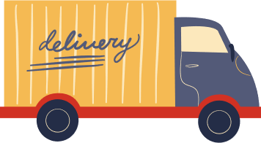



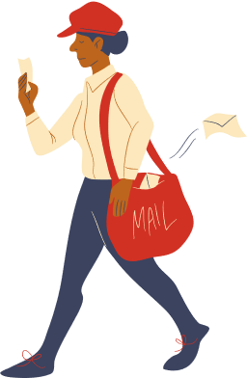


NAMASTE CONNECTION’S
Zomato Data Analysis
Presented by: Aditya Kumar

Slide 2
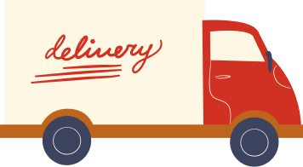

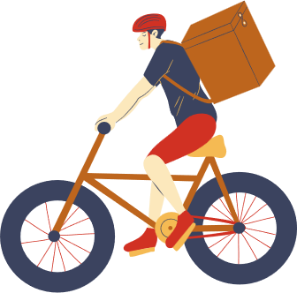
TOPICS
1
Most Popular Restaurant Type for Orders.
4
Average Spending per Order by Couples
2
Customer Votes by Restaurant Type.
5
Highest Rated Order Mode: Online vs Offline
3
Majority Ratings for Restaurants
6
Restaurant Type with Most Offline Orders for Offers

Slide 3
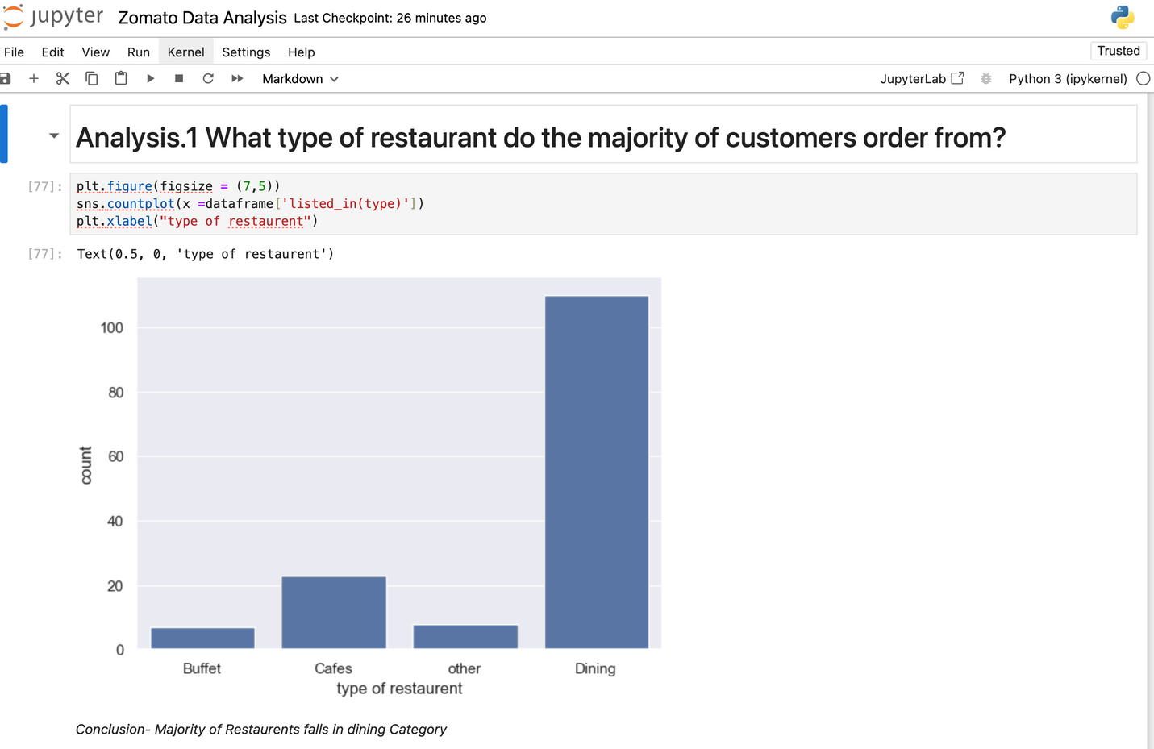
1
Most Popular Restaurant Type for Orders.

Slide 4
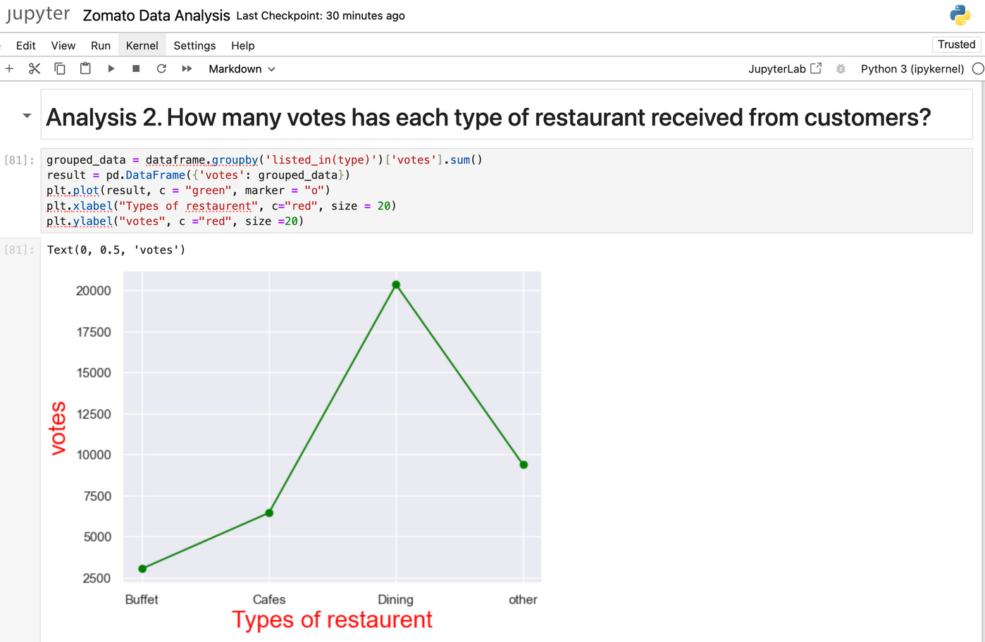
2
Customer Votes by Restaurant Type.

Slide 5
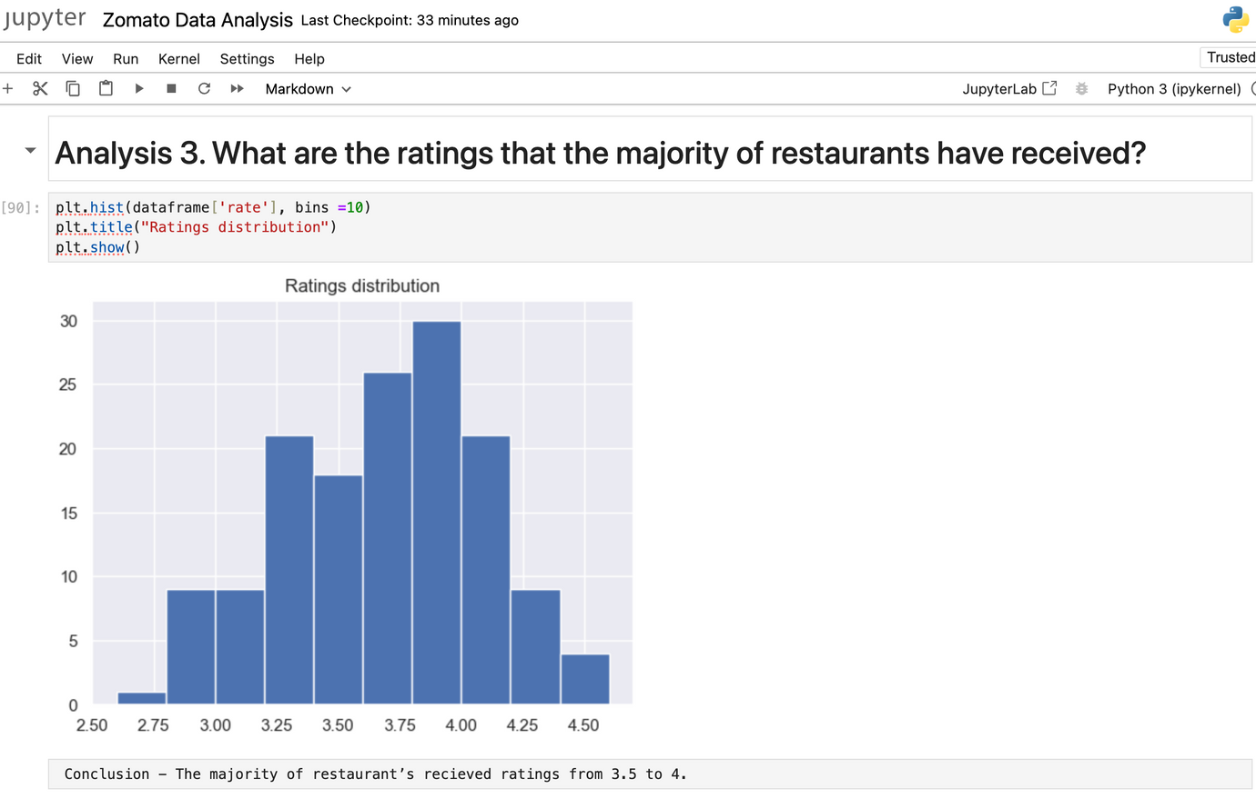
3
Majority Ratings for Restaurants.

Slide 6
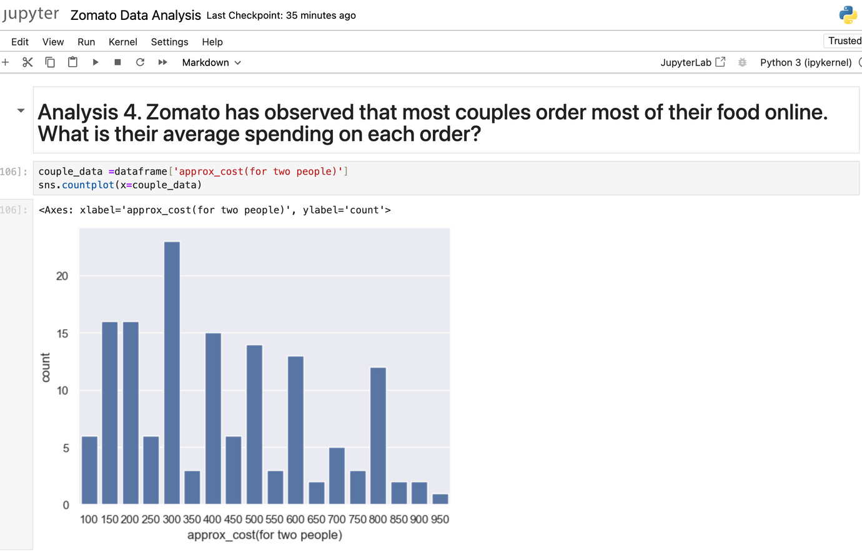
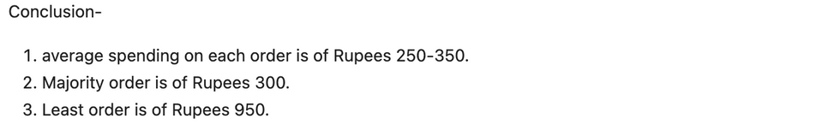
4
Average Spending per Order by Couples

Slide 7
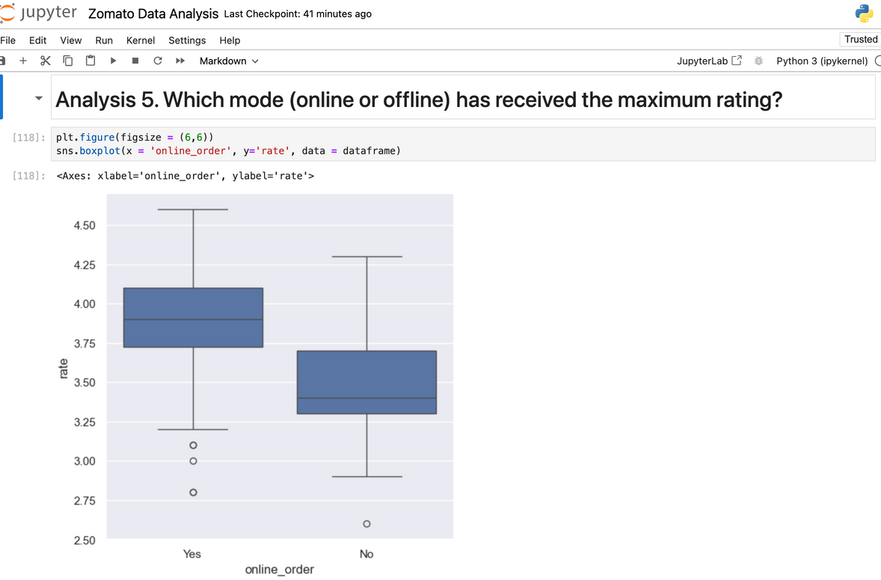
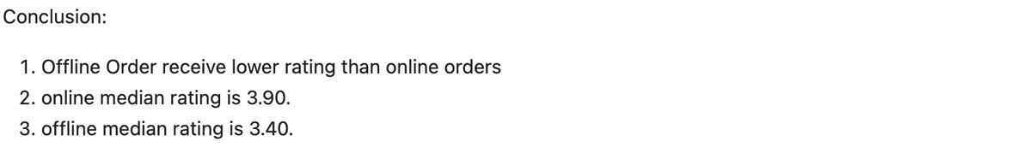
5
Highest Rated Order Mode: Online vs Offline

Slide 8
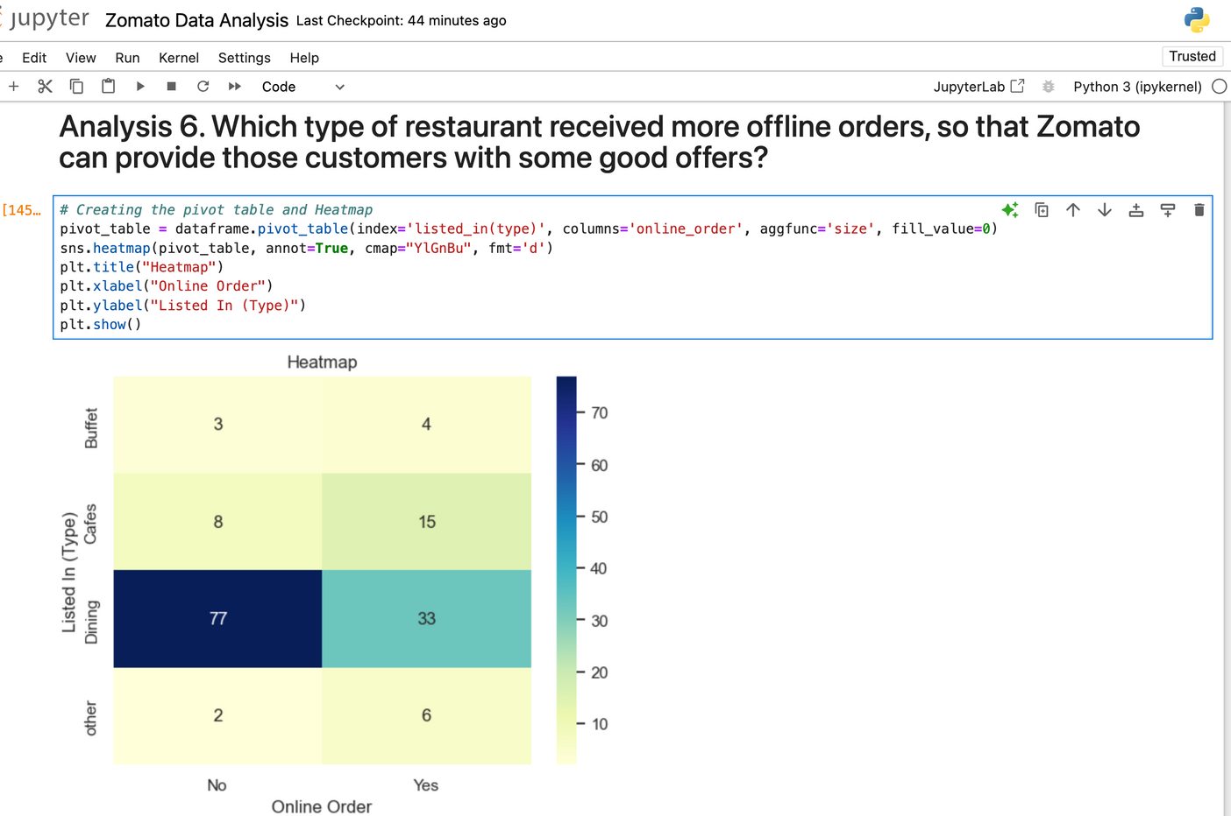
6
Restaurant Type with Most Offline Orders for Offers

Slide 9
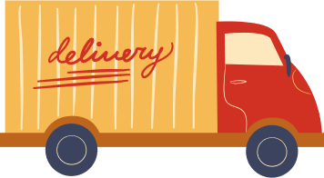


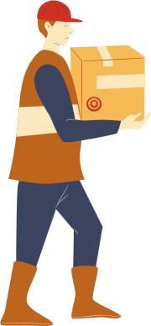
Thank you for Your Time!

